Slide 1
Preliminary Presentation - Team POBA
Senior Capstone Design

Slide 2
Client Information
POBA medical
POBA (Plain Old Balloon Angioplasty)
Startup medical device company (March 2016) located in NACET building in Flagstaff, AZ
Specialize in thermoplastic balloon manufacturing

Slide 3
Project Description
Design and manufacture an automated visual balloon inspection device
Must be compatible with different balloon lengths and sizes
Utilize rotational and longitudinal movement for inspection
Be able to determine balloon’s outer dimensions and detect defects
Notes:
POBA’s goal for us is to design an automated visual balloon inspection device. This device must be able to measure different length and sizes of balloons. Use rotational and longitudinal movement to measure balloon's outer dimensions.

Slide 4
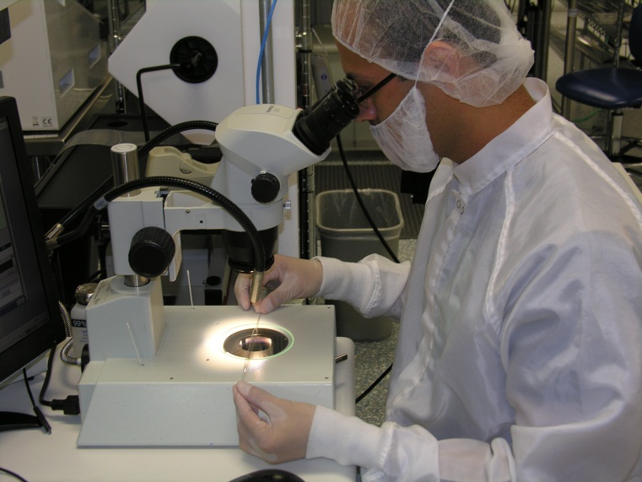
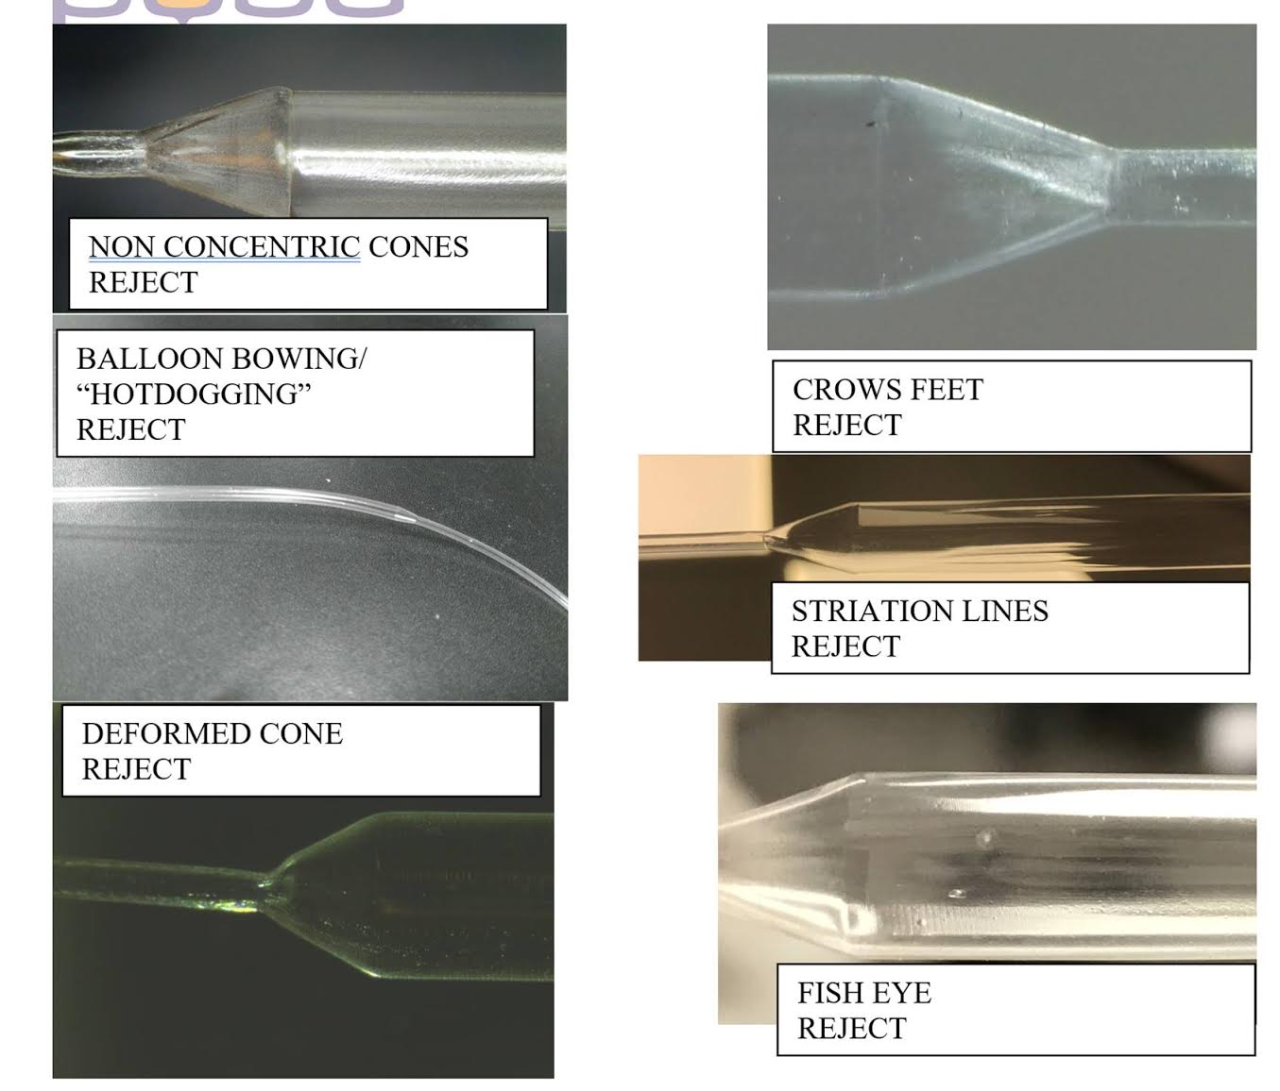
Background and Benchmarking
Balloons are Manually Inspected
Time-consuming.
Labor Intensive.
Classification Errors
Missed defects.
Disagreement on defect types.
Disagreement on pass/fail.
Discrepancies in data.
Increased Cost
Balloons wasted from bad inspections.
Notes:
These catheter balloons are manually inspected with a microscope or simply by eyeballing the balloon. Manual inspection is problematic because it is time-consuming and labor intensive. In addition, this current method causes inspectors to miss defects (such as crows feet, fish eyes, gel spots etc), disagree on defect types, disagree on whether a balloon passed or failed an inspections , and discrepancies within the data because this method is inconsistent.
Manual inspections also lead to increased cost because good balloons are wasted from the classification errors..

Slide 5
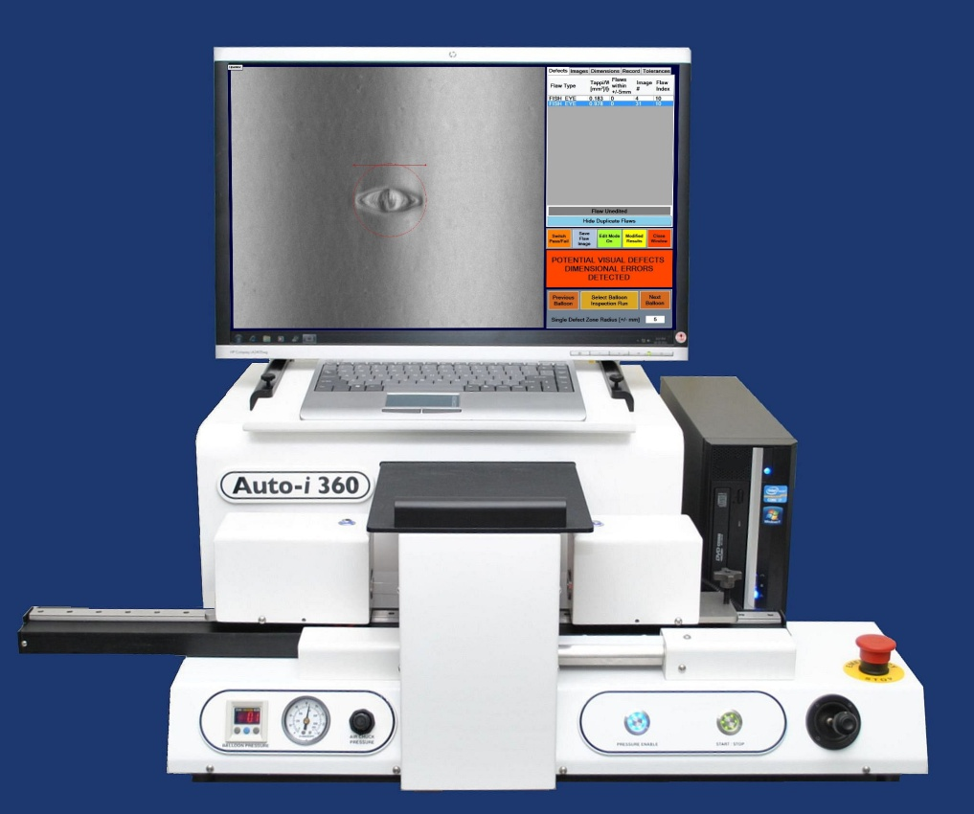
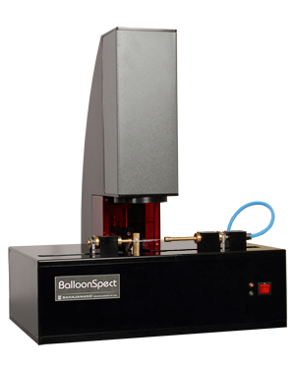
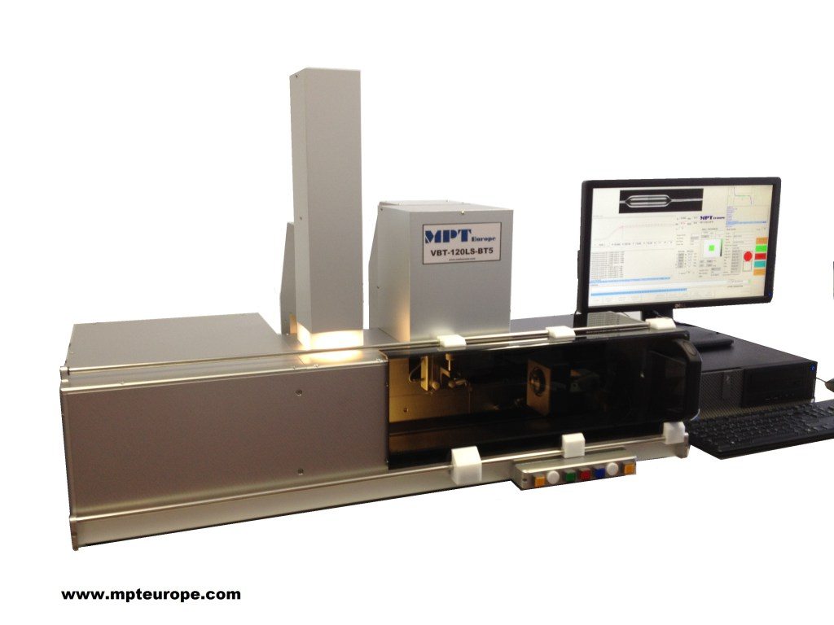
Background and Benchmarking
Auto i-360
BalloonSpect
VBT-LS
Notes:
To mitigate these problems, companies have started to use automated inspection devices. The auto i-360, BalloonSpect,and VBT-LS are current automated devices used to get repeatable and reliant data from each balloon inspection.

Slide 6
Background and Benchmarking
Features
Quick, easy setup with fast cycle times (approximately 30 seconds for standard balloons).
Automatically rotates & inspects.
Rotary air chucks made inspection process faster than standard.
Immediate detailed visual & data reports.
Classifies defect type and size with pass/fail analysis.
Software filters significantly reduce false positives.
Auto i-360
Notes:
We will be using the the auto i-360
Key features of the auto i-360
The features of the auto i-360 align with what POBA medical wants, however the device is very expensive.
The goal for this project is to recreate the auto i-360 for POBA medical so that it is inexpensive and has all of the i-360 features.

Slide 7
Customer and Engineering Requirements
1. Equipment should be able to measure all balloon sizes ranging from 1.25mm to 45mm in diameter. Balloon lengths ranging from 0mm to 325mm minimum.
2. Measure all outer balloon dimensions. (Proximal and distal neck OD, cone length and angle, working length diameter and length)
3. Measure size of visual defects (“gel spots”, ”Fish eyes”, ”Crows Feet”, etc. )
4. Measure distance between visual defects and number of defects within a specified area.
Notes:
These are the requirements that were listed in the project descriptions pdf given in bb learn.

Slide 8
Customer and Engineering Requirements
5. Inspection under polarized lighting
6. Rotation for inspection
7. Longitudinal movement for inspection
8. Inflation for inspection (Equipment must be able to withstand 40 ATM of internal pressure)
9. Equipment will be able to sit on a table
Notes:
These are the requirements that were listed in the project descriptions pdf given in bb learn.

Slide 9
Customer and Engineering Requirements
After meeting with POBA, we received more information as to what they were asking for.
Does not want any software, just a working/moving exoskeleton with all the components and a fully developed body.
Requires a full bill of materials to be able to order parts to have by january.
Under requirement #9, the design can be an entire tables size.
Need to have full CAD design by end of semester.
Our product needs to be less expensive than the SOTA equipment
Notes:
POBA understands that we are all ME’s and will not ask us to add software to the project, all we are required to do is design the machine and get it to work so that they can take the project further. Size requirements up to an entire table. POBA is not concerned with how big or small it will be. POBA is not looking for any preliminary products prior to the CAD model.

Slide 10
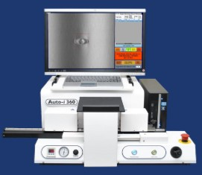
Designs Considered
Bulky design
Larger screen allows us to read data easier
Auto i360
Notes:
The Auto-i 360 is the current model in the market that we are using as our benchmark. This is the model that POBA is asking us to duplicate but on a cheaper scale. The other device that was listed on the project description pdf is a slimmer design that could be something that we take a look into.

Slide 11
Designs Considered
BalloonSpect
VBT-LS
Overhead camera design allows for easy application of polarized lighting
Kinda tall but can allow for smaller surface area on the table.
Big and bulky but will still fit the design constraint
Notes:
The BalloonSpect is a Design that we recently discovered that shows the camera as hanging over the balloon instead of sitting behind it.

Slide 12
Schedule and Budget
Schedule
Fall Semester
10/23
Present POBA prototype drawing and overall idea
11/6
Start solidworks
12/14
Full solidworks mock up of prototype
Spring Semester
Building device
Budget
Expecting $15,000
Cap is $20,000

